Slide 1
PINNs for the Heat Equation
Ilia Kheirkhah

Slide 2
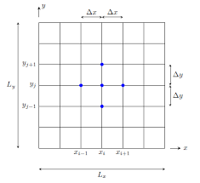
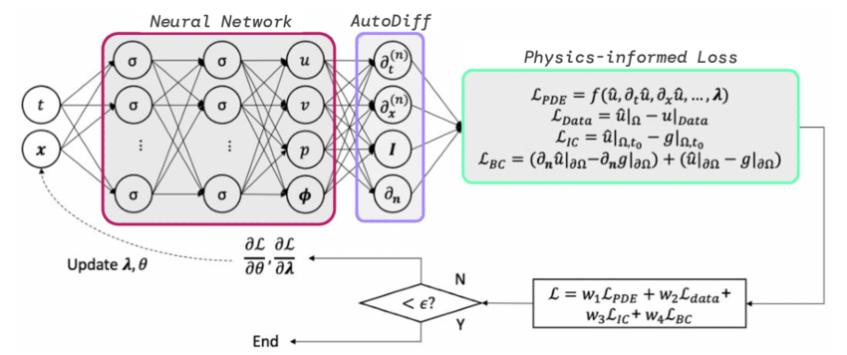
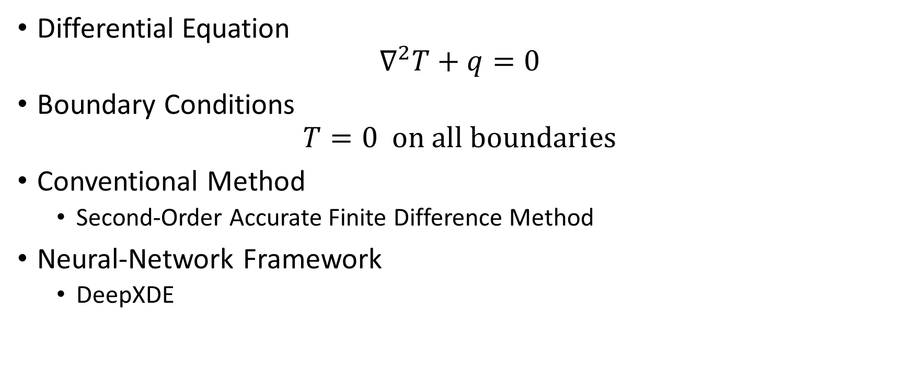
Problem Setup
Differential Equation
$$∇^{2}T+q=0$$
Boundary Conditions
$$T=0 \text{on} \text{all} \text{boundaries}$$
Conventional Method
Second-Order Accurate Finite Difference Method
Neural-Network Framework
DeepXDE

Slide 3
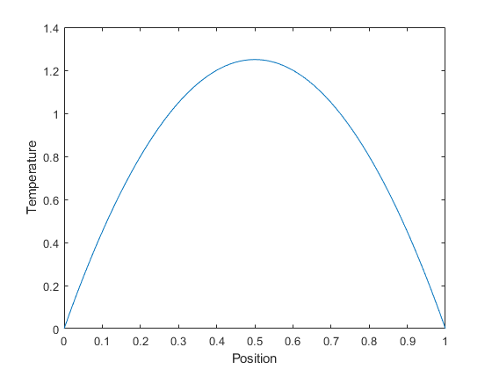
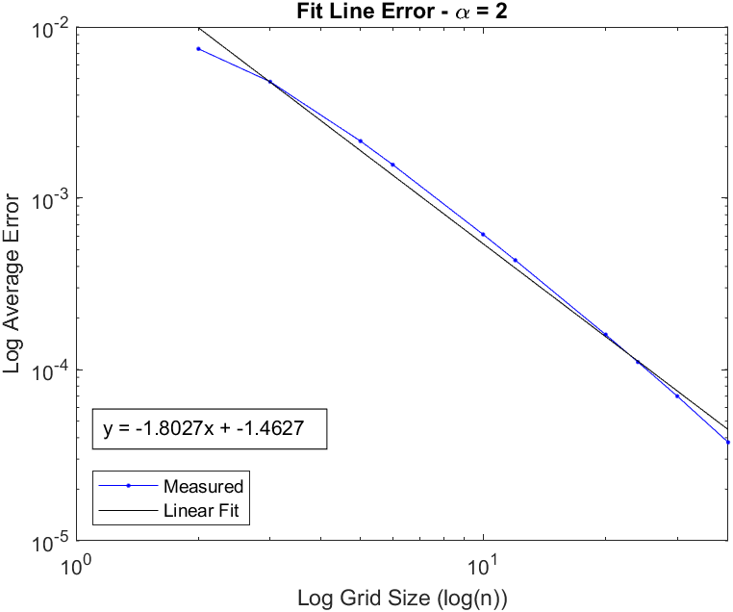
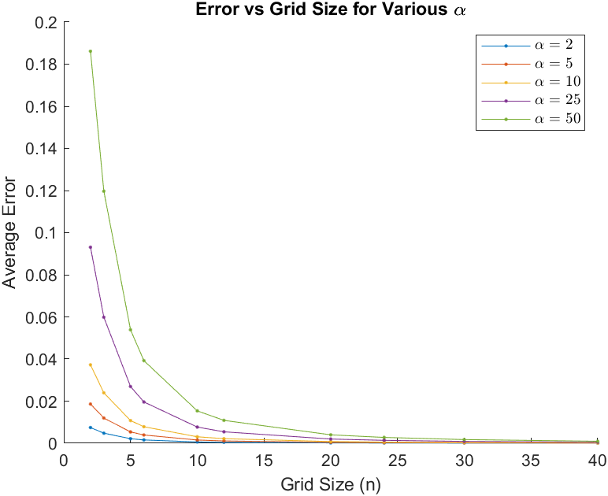

Conventional Methods 1D ($q=10$)

Slide 4
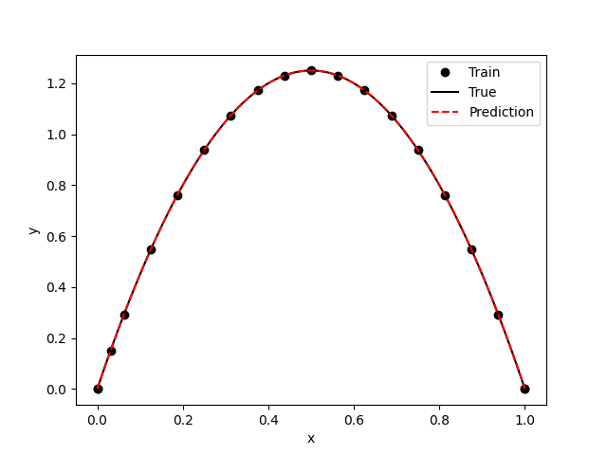
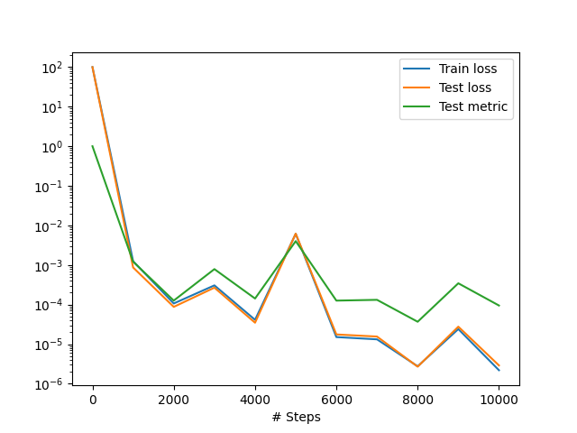

PINN 1D Results ($q=10$)

Slide 5
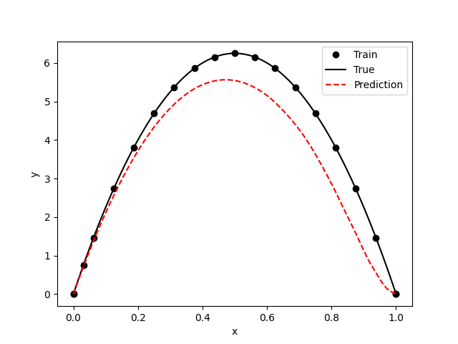
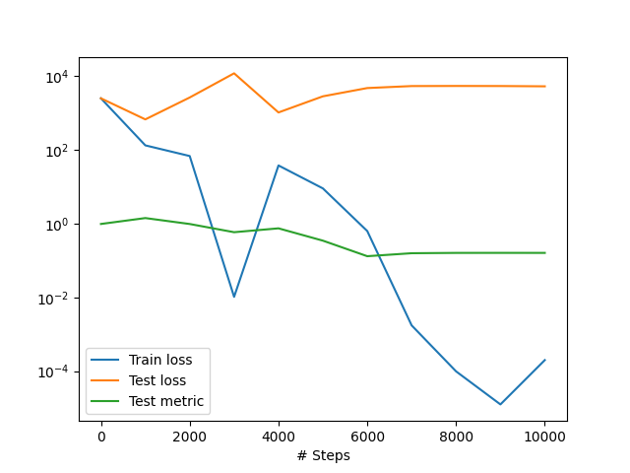

PINN 1D Result ($q=50$)

Slide 6
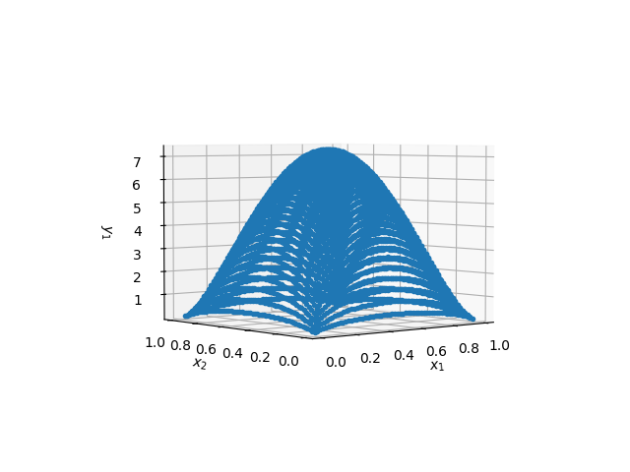
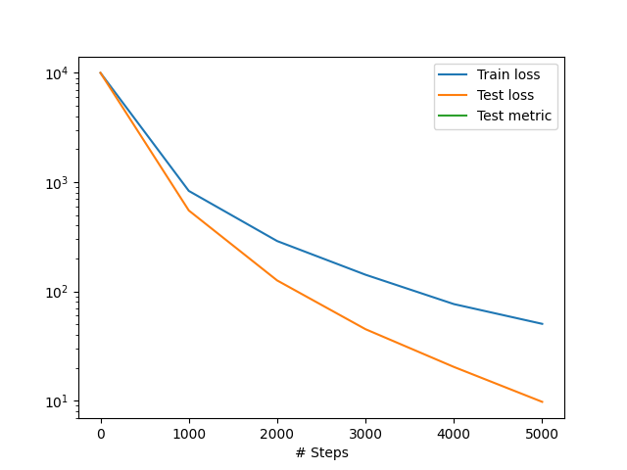

PINN 2D Results ($q=100$)

Slide 7
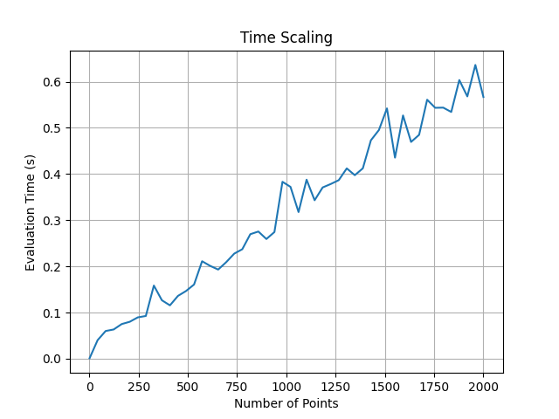
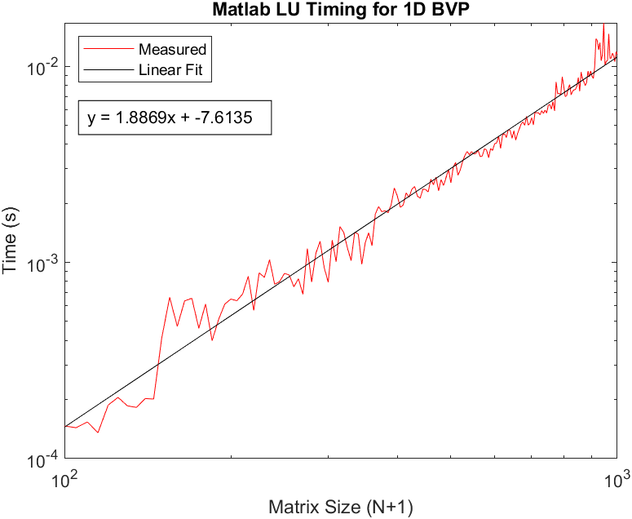
PINN Time Scaling

Slide 8
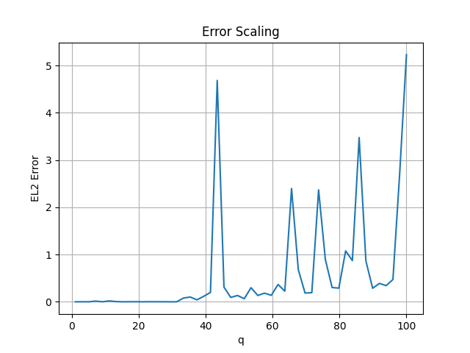
PINN Error Scaling

Slide 9
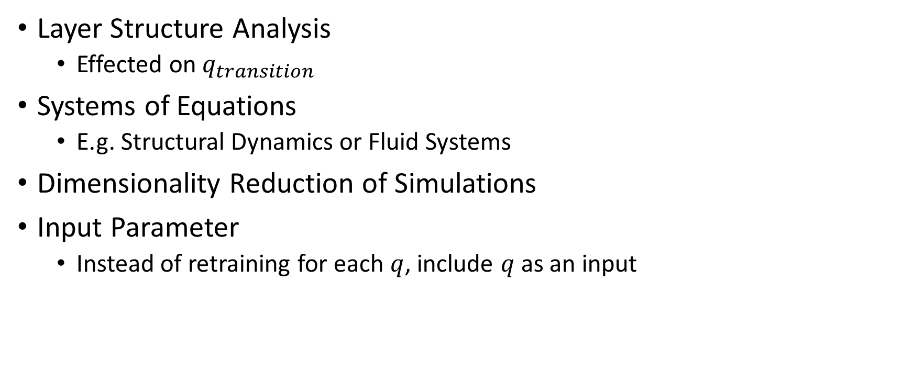
Future Ideas
Layer Structure Analysis
Effected on $q_{transition}$
Systems of Equations
E.g. Structural Dynamics or Fluid Systems
Dimensionality Reduction of Simulations
Input Parameter
Instead of retraining for each $q$, include $q$ as an input

